Slide 1






LastMinuteSottoCasa
perche’il cibo ... non si butta!
Francesco Ardito - Colloqui di Dobbiaco – 30/09/2017

Slide 2


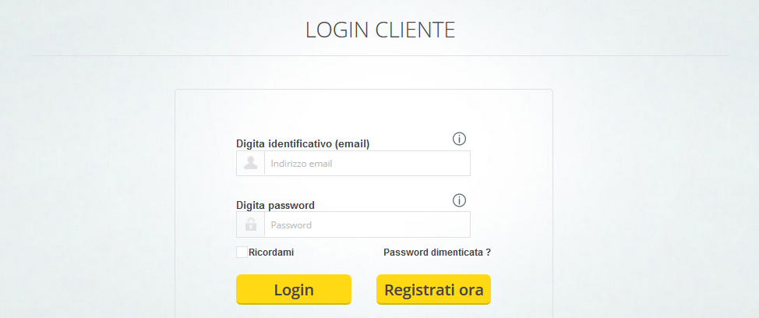
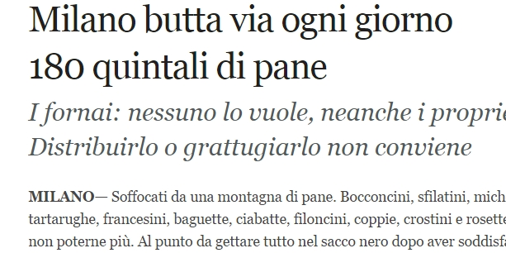

Slide 3
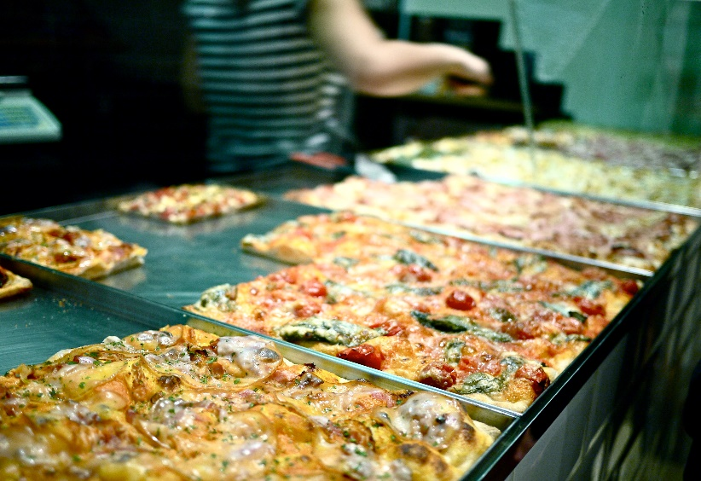
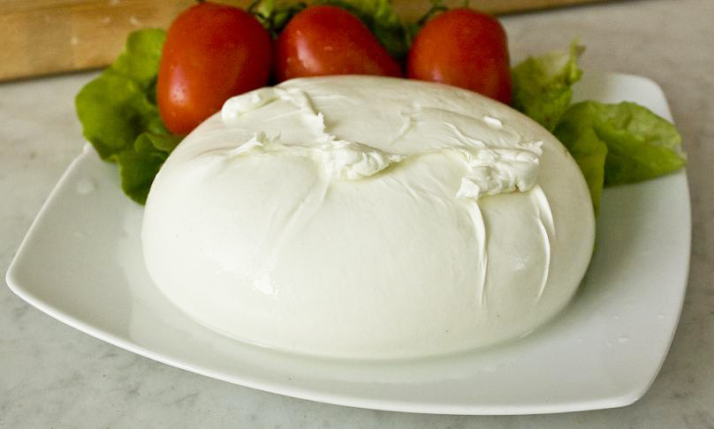
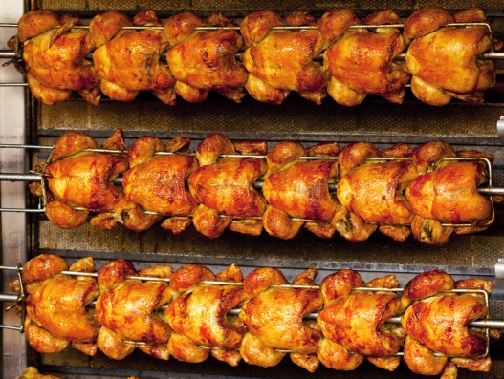
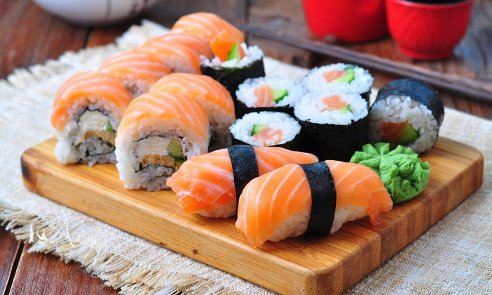
A huge, underestimated problem!

Slide 4
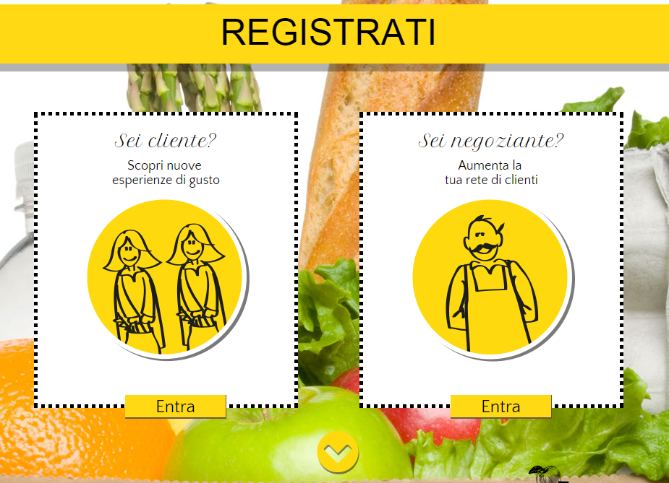
Simple to explain, simple to understand... simple to use!

Slide 5
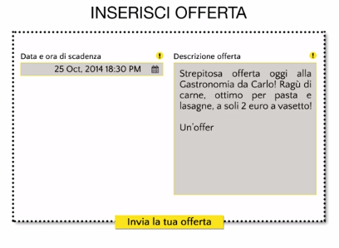
Just like sending a SMS – Are you able to simply type your text?

Slide 6

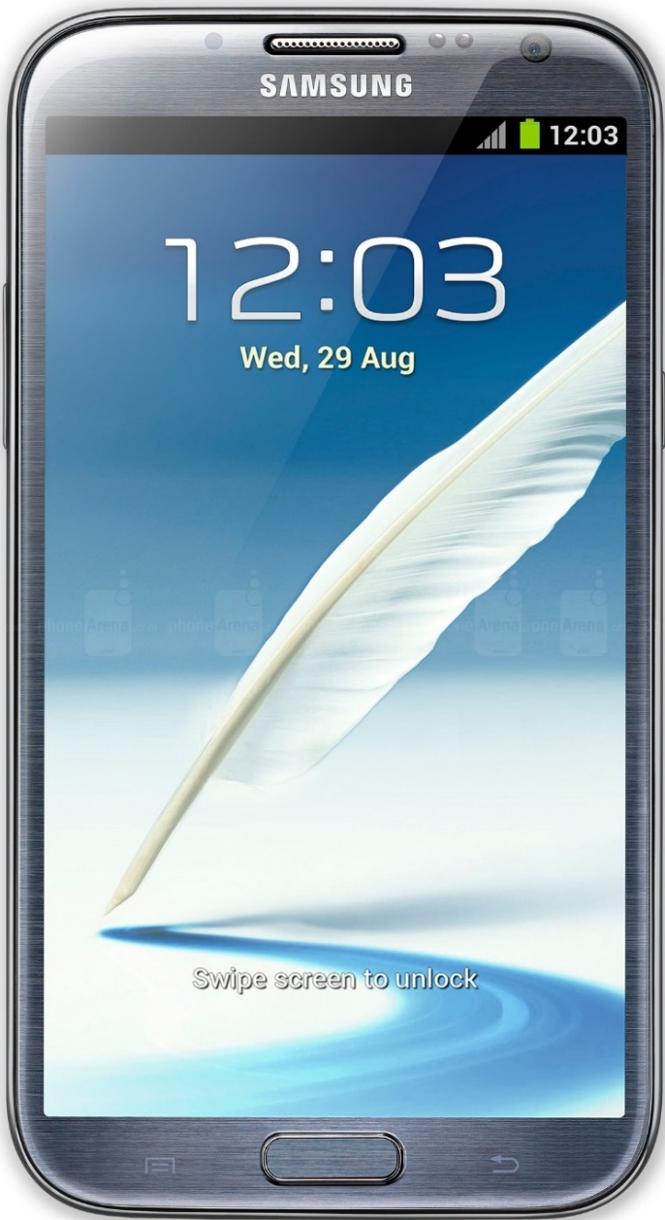
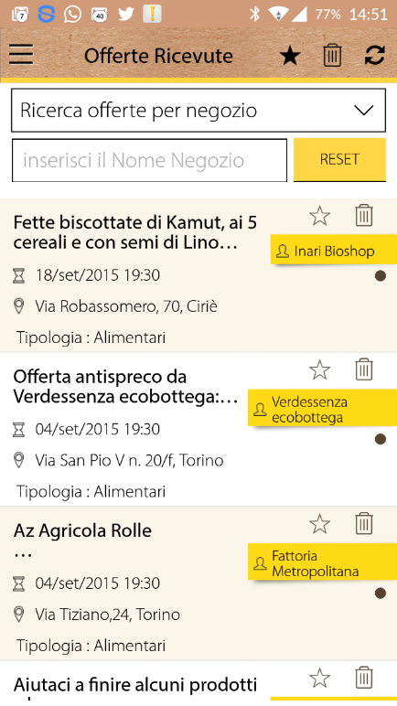
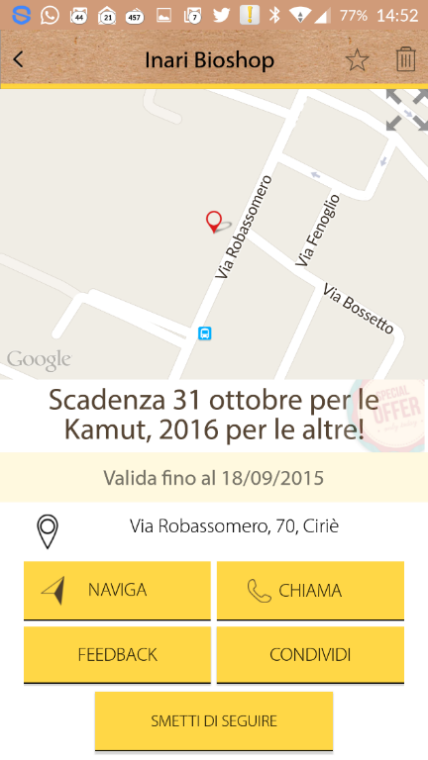




Slide 7
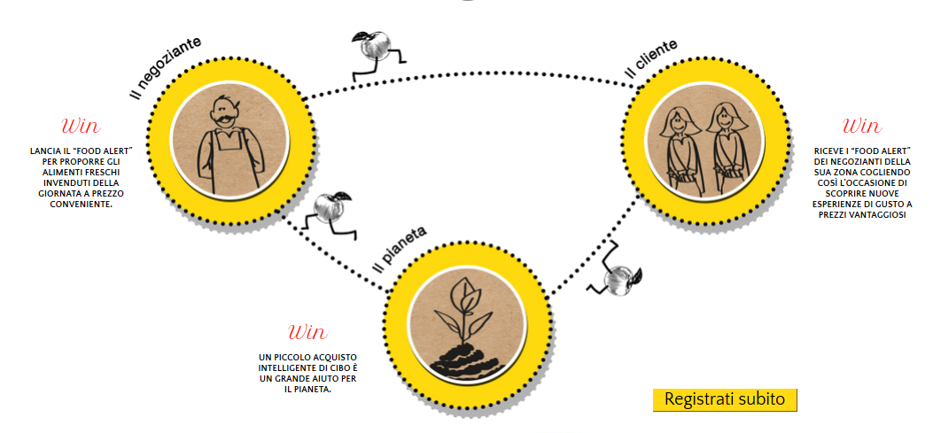
LastMinuteSottoCasa - a profitable Win Win Win project!

Slide 8
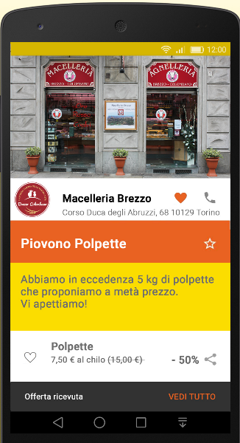
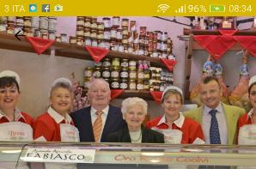



Slide 9
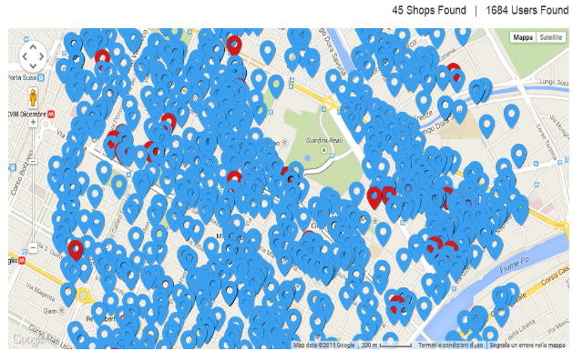
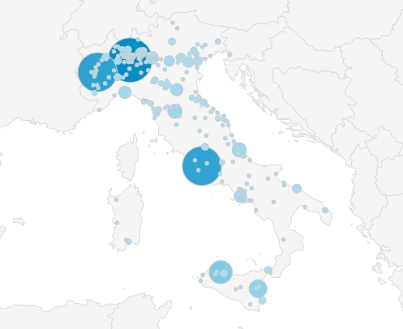
65.000 users already registered!
Torino
Italy

Slide 10
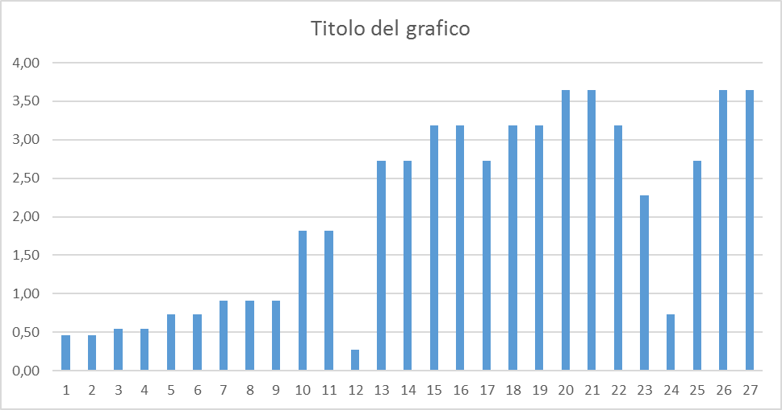

Results
Every single month, we are saving 3.5 Tons of fresh food from waste!

Slide 11
A unique, passionate, challenging team!

Slide 12
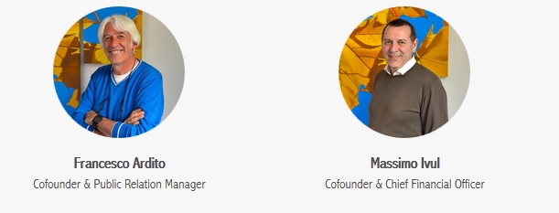
Strategy & Experience

Slide 13
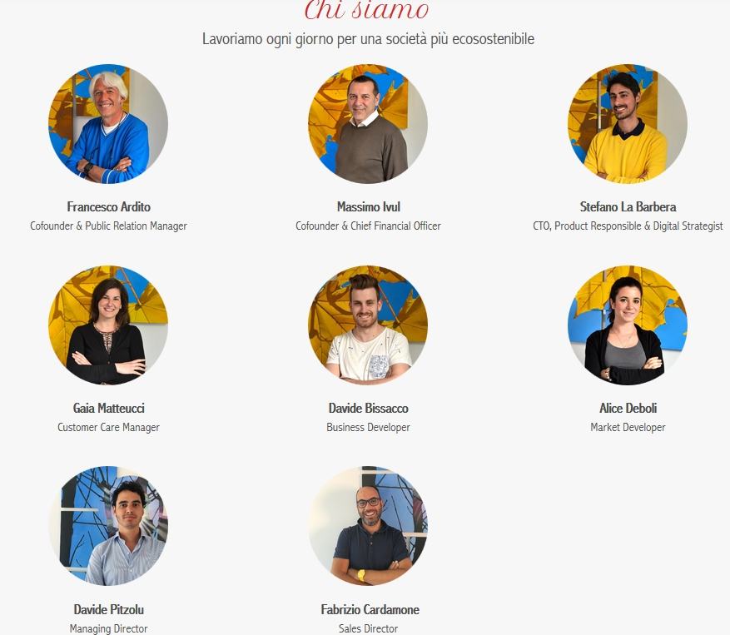
Passion & Energy

Slide 14




























Slide 15

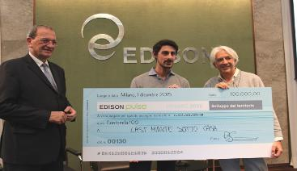











Slide 16



Slide 17
Business Model

Slide 18
Monthly fee
Standard
Supermarket
Comuni
Free App
Personal data

Slide 19
Partnership / Investments

Slide 20


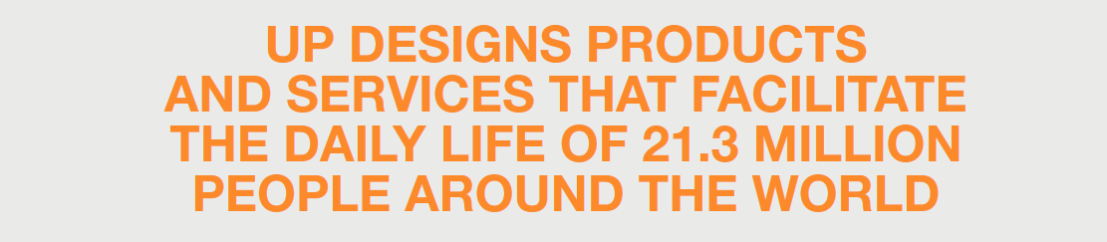


Slide 21
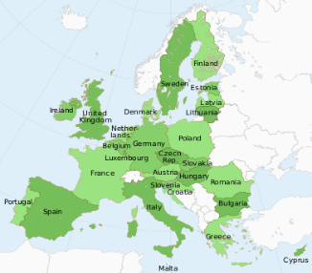
What’s next?
EU Expansion 2018

Slide 22
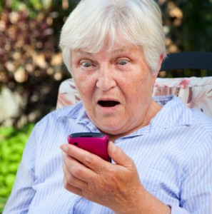
Only for young people? Not at all !!!

Slide 23

LastMinuteSottoCasa
perche’il cibo ... non si butta!
GRAZIE / THANK YOU
Francesco Ardito – francesco.ardito@lastminutesottocasa.it

